Slide 1
Finding Neighbourhood

Slide 2
Why Predict Suitable Neighbourhood?
There can we different reasons why a person have to shift to a new house .In such a case he needs to find a neighborhood in which he is most comfortable. So predicting Suitable Neighborhood for a person using machine learning may lead to efficiently find such a neighbourhood

Slide 3
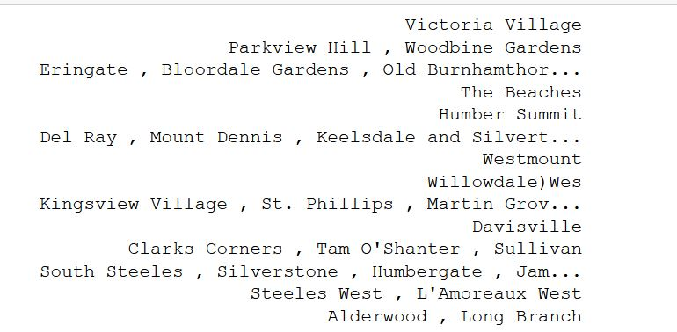
How do we do it?
We ask the user for his present postal address with the help of which we can know what his tastes are and what are his needs. Using this data we cluster all other neighbourhood and present them in a sorted order with most suitable appearing at first.

